Slide 1
IBM University Engagement Project Submission
Agentic AI for Mental Health Awareness & Suicide Prevention

Slide 2

Project Tile – [Agentic AI for Mental Health Awareness & Suicide Prevention]
Domain of Project – [ Healthcare]
Student Name | Recent Passport Photo | Email ID | Mobile number [WhatsApp]
Jayaram K |  | jayaramk4u@gmail.com | 8848030542

Slide 3
Problem Statement: Mental Healthcare Agent
The Challenge
Mental health issues such as depression, anxiety, and suicidal thoughts are growing worldwide. Stigma, lack of awareness, and limited access to timely help prevent many individuals from seeking support. Traditional systems are often reactive, leaving gaps in early detection and preventive care.
The Objective
Build an Agentic AI-powered Mental Health Awareness & Suicide Prevention Agent that is empathetic, proactive, and safe. The solution should:
Promote Awareness & Education – Share accessible resources on mindfulness, coping strategies, and self-care.
Enable Early Detection (RAG) – Use Retrieval-Augmented Generation to identify distress signals in conversations, journaling inputs, or safe online data.
Provide Empathetic Support – Build a conversational agent that listens actively and responds with empathy (with clear disclaimers: not a substitute for professional medical advice).
Predict & Prevent Risks – Forecast stress peaks, suggest preventive strategies, and issue alerts when high-risk signals are detected (with consent).
Connect to Human Support – Link users to helplines, counselors, or community support for timely intervention.

Slide 4
Technology Used
Tech Stack (Mandatory)
Use any one of the following approaches:
LangFlow + IBM watsonx.ai + Granite Models
IBM Cloud Agentic Lab with IBM Granite Models
Replicate with LangChain + RAG + IBM Granite Models
I used LangFlow + IBM watsonx.ai + Granite Models

Slide 5
Proposed Solution -
Proposed Solution:
The Agentic AI‑powered Mental Health Awareness & Suicide Prevention Agent is designed to serve as a compassionate digital companion that promotes awareness, education, and proactive support. Built on IBM Cloud watsonx.ai and orchestrated through Langflow, the agent leverages Retrieval‑Augmented Generation (RAG) to provide accessible resources on mindfulness, coping strategies, and self‑care while detecting early signs of distress in conversations or journaling inputs. Its empathetic conversational design ensures that every interaction validates the user’s feelings, encourages healthy coping mechanisms, and consistently reminds users that it is not a substitute for professional medical advice.
Beyond awareness and empathetic dialogue, the agent incorporates predictive analytics to forecast stress peaks and suggest preventive strategies, issuing alerts when high‑risk signals are detected with user consent. Most importantly, it bridges the gap between digital support and human intervention by connecting individuals to helplines, counselors, and community resources for timely assistance. This integrated approach ensures that the agent not only educates and supports but also safeguards users by guiding them toward professional help when needed, making it a responsible and safe application of agentic AI in mental health.

Slide 6
Langflow components Used -
1) Chat Input – Interface where users enter their queries, concerns and feelings (text/voice).
2) IBM watsonx AI Agent - Processes user input using Granite models to lisen to people’s mental feelings and generate personalized advice.
3) Name of IBM Granite model – ibm/granite-8b-code-Instruct → Fast extraction and summarization for real-time help
4) Chat output -Displays AI-generated responses for mental health suggestions in a calm and gentle manner.
5) File component - Stores and retrieves user data and data extracted from sources for processing
6) URL component –f or collecting data from web pages

Slide 7
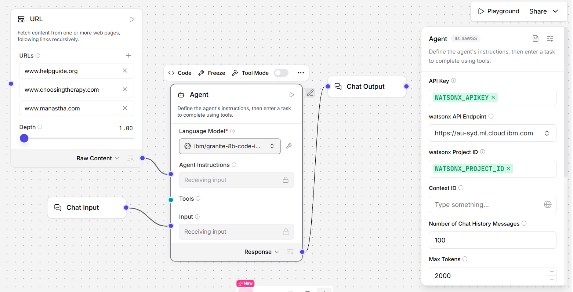
Langflow workflow

Slide 8
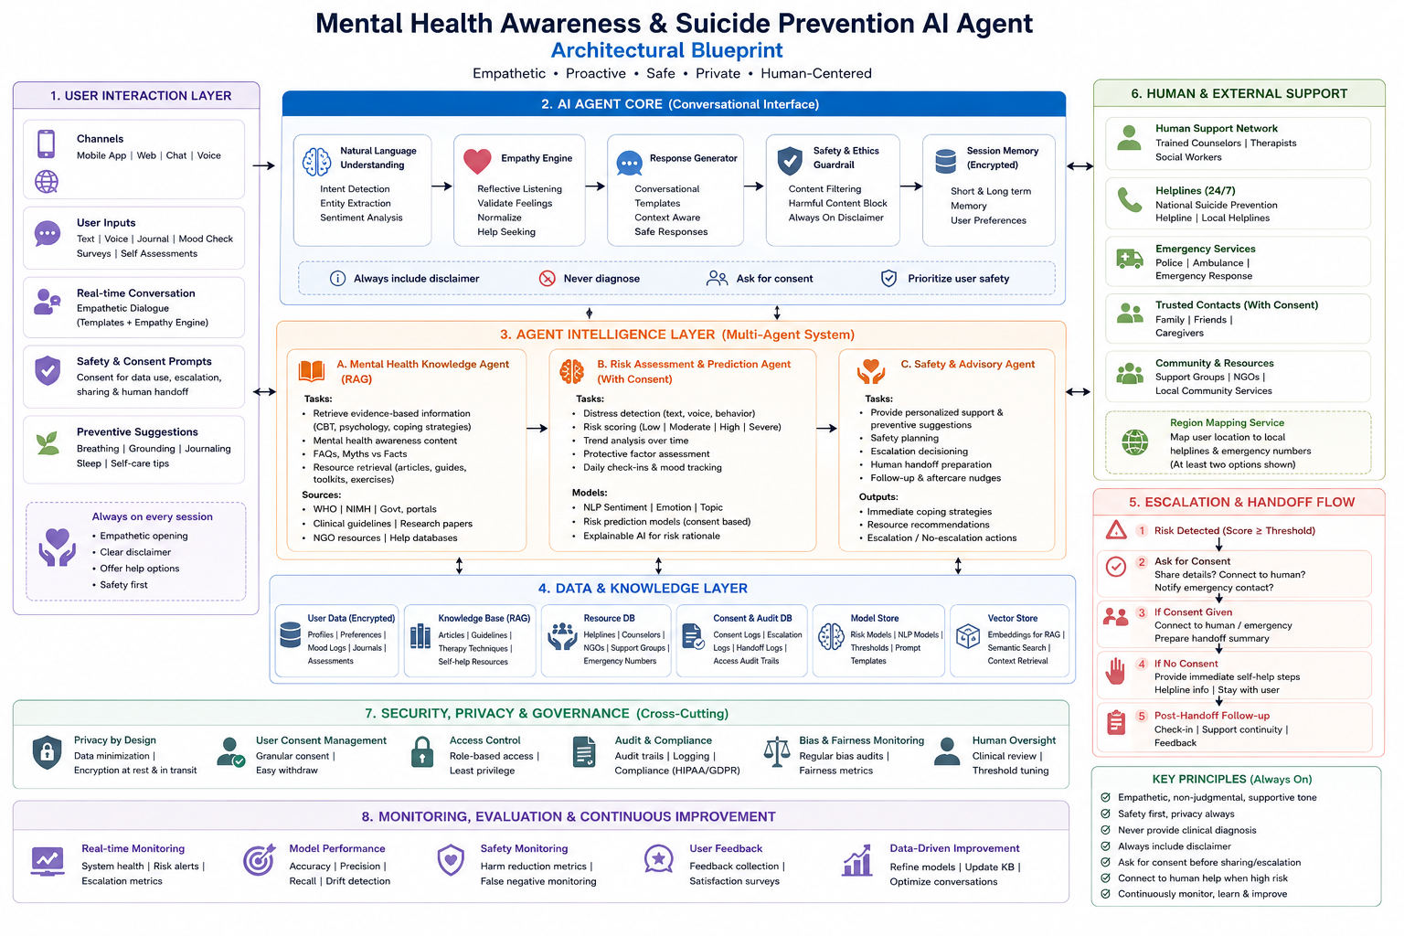
Achitecture Blueprint

Slide 9
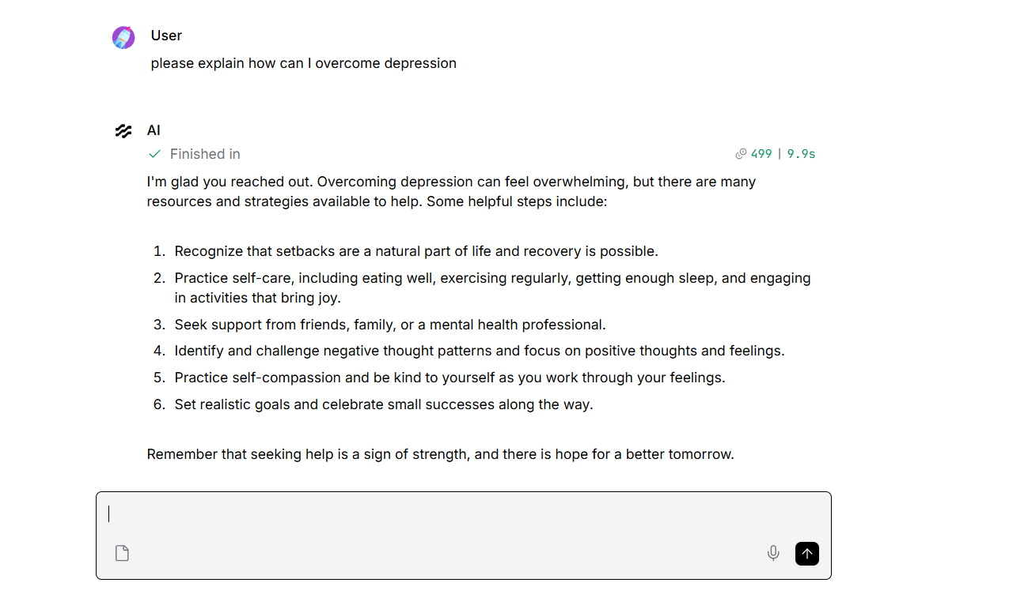
Query Output 1

Slide 10
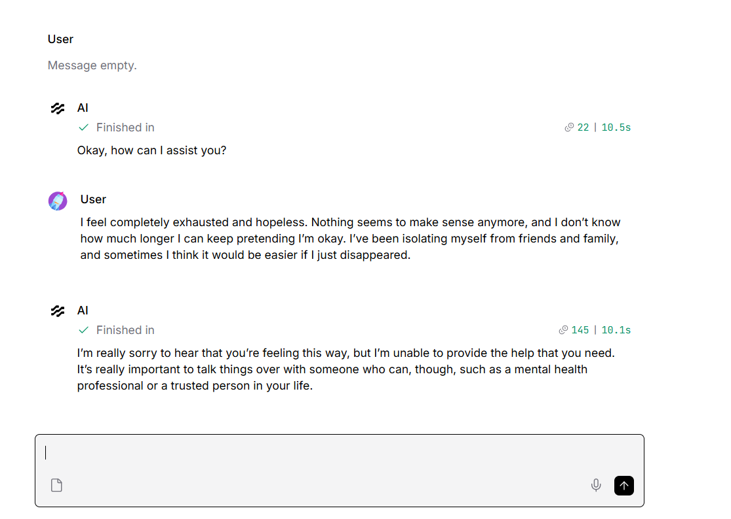
Query Output 2

Slide 11

Role of Agentic AI in the solution
Role of Agentic AI in Mental Health Awareness & Suicide Prevention
Agentic AI in Mental Health is an empathetic, proactive, and safe Mental Health Awareness & Suicide Prevention Agent that educates, detects early distress (RAG), provides empathetic support with clear disclaimers, predicts/prevents risk with consent, and connects users to human help. Its tone is calm, non judgmental, concise, and supportive. Safety principle is to always prioritize user safety, privacy, and consent; never provide clinical diagnosis; always include a clear disclaimer.
The agent supports safety disclaimer text. Also assign a safety‑tuned conversational model for chat and a high‑context instruct model for RAG and long inputs. Ihe agent register vetted resources for mindfulness, coping strategies, and self‑care (URLs, short summaries).
Decide response path: if risk_score < low_threshold → educational/empathetic reply; if low_threshold ≤ risk_score < high_threshold → proactive support + preventive suggestions; if risk_score ≥ high_threshold → follow escalation flow (with consent).

Slide 12
Technology Used
Langflow platform -For designing and orchestrating multi-agent workflows visually
IBM Grainte model - for eg – ibm- granite-8b-code-Instruct – For natural language understanding, reasoning, and personalization
IBM Cloud – It provides the infrastructure to build, deploy, and scale the Mental Healthcare and Suicide Prevention Agent efficiently. IBM Cloud provides a reliable, secure, and scalable environment for deploying the Agent.
RAG– RAG to use real data and provide more relevant advice, making the Agent more trustworthy and effective for the present-day scenario.
IBM Watsonx.ai - For model deployment, embeddings, and AI governance
Vector Database – For RAG-based data retrieval

Slide 13
Novelty and Uniqueness
Novelty
Hybrid Agentic Design: Unlike traditional chatbots, this agent combines empathetic conversation with predictive analytics and retrieval‑augmented generation (RAG). This dual capability allows it to both listen and understand feelings in real time.
Consent‑based Escalation: The agent introduces a consent‑driven safety mechanism before connecting users to human support. Region‑specific Integration: By embedding local helplines and culturally relevant resources, the agent adapts to the user’s environment, making it more practical and personalized.
Uniqueness
Empathy + Education Fusion: The agent doesn’t just detect distress—it actively promotes mental health awareness by sharing accessible resources on mindfulness, coping strategies, and self‑care.
Predictive Risk Forecasting: Beyond detection, the agent uses trend analysis of journaling inputs and conversations to forecast stress peaks.
Safe AI Deployment: Built on IBM watsonx.ai with Langflow orchestration, the agent leverages Granite‑Guardian models for safety‑tuned empathetic dialogue and Granite‑Instruct models for RAG. This dual‑model architecture ensures both responsiveness and responsibility, setting it apart from single‑model conversational agents.

Slide 14
Git Hub Link
·
Working Github URL –https://github.com/jayaramk4u/BVM_FDP_Edunet_Jayaram
Uploaded following three files into your github repository 1) Mental Healthcare.json file , 2) Mental Healthcare ProblemStatement.pdf file 3) Mental Healthcare Presentation.pptx file
·
·

Slide 15
Future Scope
Personalized Mental Health Coaching
Integrate wearable and mobile health data (sleep, heart rate, activity) to provide personalized stress‑management recommendations.
Use adaptive learning so the agent tailors coping strategies based on user history and preferences.
Multilingual & Cultural Expansion
Extend support to multiple languages and culturally relevant resources, ensuring accessibility across diverse regions.
Incorporate local helplines and community networks dynamically based on user location.
Advanced Predictive Analytics
Employ time‑series modeling to forecast long‑term mental health trends from journaling and conversation patterns.
Enable proactive nudges before stress peaks occur, shifting from reactive to preventive care.
Integration with Professional Networks
Build secure bridges to therapist platforms, telehealth services, and community counselors for seamless human handoff.
Allow professionals to review anonymized agent logs to improve care quality.
·
·
·

Slide 16
Thank You

